Slide 1
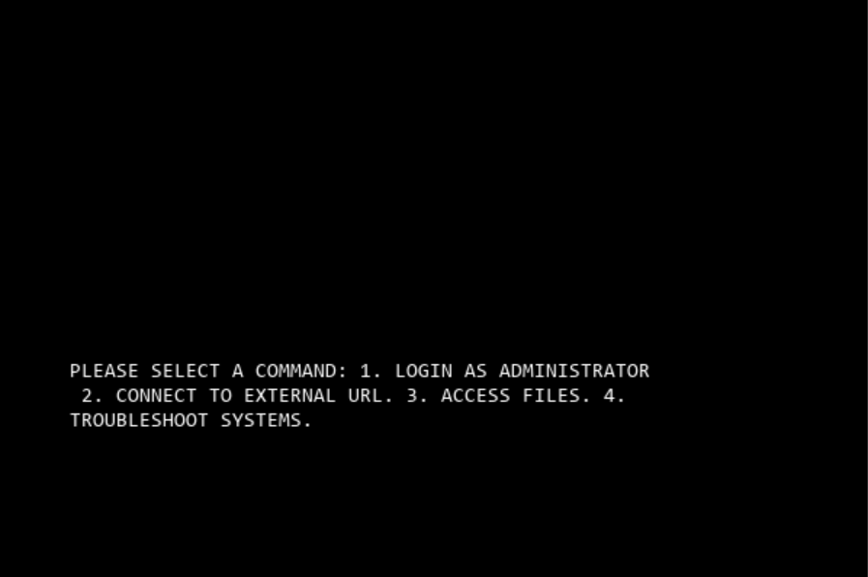
The Vishnu Project
Team Member(s): Drew Gaylor
What is The Vishnu Project?
Screenshot
Text-based multi-media adventure game that makes use of outside-of-program media to form an “Alternate Reality Game” kind of experience that requires the player to use all aspects of their computer.
Covers topics such as consciousness, free will, the rights of conscious machines, entropy, and absurdism.
Github Link: https://github.com/ksu-is/TheVishnuProject

